Slide 1
IN723 VRF Lite
Multi VRF (VRF Lite)

Slide 2
Resources
Blog Guide
https://ccieblog.co.uk/mpls/vrf-lite
Configuration Guides
http://www.cisco.com/c/en/us/td/docs/switches/lan/catalyst4500/12-2/31sg/configuration/guide/conf/vrf.pdf
http://www.cisco.com/c/en/us/td/docs/ios/12_2sb/12_2sba/feature/guide/vrflite.html

Slide 3
VRF
Virtual Routing and Forwarding
Allows multiple instances of a routing table to co-exist on a router concurrently
Each instance is called a VRF
Notes:
VLAN analogy

Slide 4
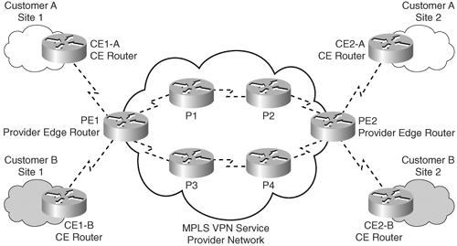
VRF
Allows overlapping IP address space
Typically used with MPLS VPNs on Provider Edge routers (PE)
Notes:
CE = customer edge
P = provider
PE = provider edge

Slide 5
Multi VRF CE / VRF lite
VRF supported on devices without MPLS
Extends limited PE functionality to Customer Edge (CE)
CE can be any router (not limited to edge)
Maintain multiple routing tables instances on a single device
Providing for increased privacy and security
Reduce cost (reuse existing hardware)

Slide 6
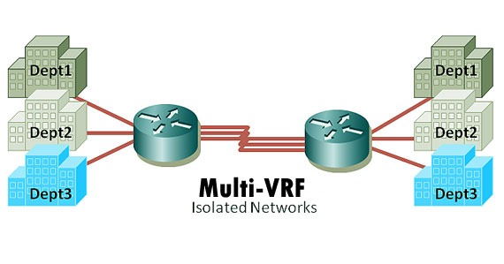
Multi VRF CE / VRF lite
Separate circuits required for each VRF (no MPLS).
An interface can belong to a single VRF
Separate routing protocol instance (or static) required for each VRF.
Notes:
Separate physical circuits

Slide 7
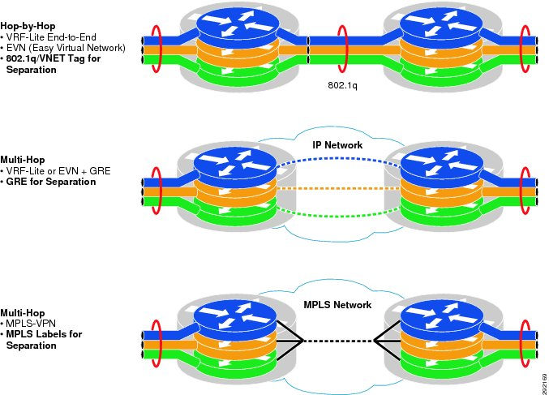
Notes:
Circuit options / comparisons
802.1q
GRE
MPLS
EVN simplifies VR-Lite config

Slide 8
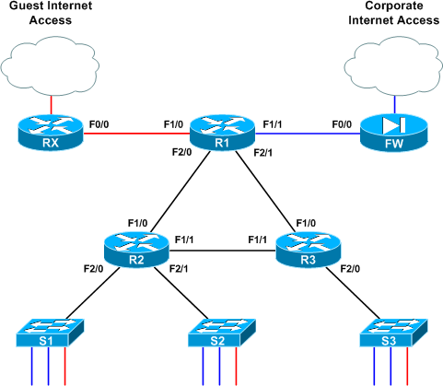
Notes:
VRF-lite configured on R1. R1 has separate routing tables for Guest & Corporate.

Slide 9
RD & RT
An RD (Route Distinguisher) is a 64-bit unique identifier that is prepended to each VRF route to uniquely identify it on a multi VRF router.
Route targets (RTs) are additional identifiers used in an MPLS VPN domain to identify VPN membership
RTs are used by MP-BGP to allow inter-VRF route exchange
Notes:
Only RD required for VRF-Lite configuration

Slide 10
VRF Configuration
ip vrf SECURE
rd 100:10
interface FastEthernet0/1
ip vrf forwarding SECURE
ip address 192.168.12.1 255.255.255.0
Configuring ip vrf forwarding <vrf name> on an interface will cause all existing IP addressing on that interface to be removed
rd format = <AS>:<arbitrary number>
Notes:
Note – RT config not required here

Slide 11
VRF Aware Commands
Remember to use the correct command e.g
show ip route vrf <vrf-name>
ping vrf <vrf-name> <ip>
telnet <ip> /vrf <vrf-name>

Slide 12
VRF-Lite with OSPF
ip vrf SECURE
rd 123:11
!
ip vrf OPEN
rd 456:22
!
interface FastEthernet0/1
no shutdown
!
interface FastEthernet0/1.1
encapsulation dot1q 12
ip vrf forwarding SECURE
ip address 192.168.12.1 255.255.255.0
!
interface FastEthernet0/1.2
encapsualtion dot1q 13
ip vrf forwarding OPEN
ip address 192.168.13.1 255.255.255.0
router ospf 1 vrf SECURE
router-id 10.1.1.1
network 192.168.12.1 0.0.0.0 area 0
!
router ospf 2 vrf OPEN
router-id 10.1.1.2
network 192.168.13.1 0.0.0.0 area 0
Notes:
Note OSPF router-id must be unique amongst all processes on router (locally significant).

Slide 13
MP-BGP
Multi protocol BGP
Allows different types of addresses (address families) to be distributed in parallel (over same session)
MP-BGP supports IPv4, IPv6, Multicast, MPLS VPN
MP-BGP config required to support VRF-Lite for BGP. This allows routes to be exchanged between VRFs by using route-targets.

Slide 14
Vrf-Lite With MP-BGP Config
ip vrf SITEA
rd 123:11
route-target export 123:11
route-target import 123:11
!
ip vrf SITEB
rd 456:22
route-target export 456:22
route-target import 456:22
!
interface FastEthernet0/1
no shutdown
!
interface FastEthernet0/1.1
encapsulation dot1q 12
ip vrf forwarding SITEA
ip address 192.168.12.1 255.255.255.0
!
interface FastEthernet0/1.2
encapsulation dot1q 13
ip vrf forwarding SITEB
ip address 192.168.13.1 255.255.255.0
router bgp 100
router-id 10.1.1.1
bgp log-neighbor-changes
neighbor 172.16.1.2 remote-as 100
!
address-family ipv4 vrf SITEA
neighbor 192.168.12.2 remote-as 200
neighbor 192.168.12.2 activate
!
address-family ipv4 vrf SITEB
neighbor 192.168.13.2 remote-as 300
neighbor 192.168.13.2 activate
Notes:
Non address-family peers use global table

Slide 15
BGP VRF Aware Commands
BGP show commands
show ip bgp vpnv4 vrf <vrf-name>
show ip bgp vpnv4 all summary

